Slide 1

Diego Pinto
-Computer engineering
Aastha Dave
-Computer science

Slide 2


History of Netflix
Netflix is founded in 1997
In 99 the company offers unlimited subscription
The company did have a spike in subscribers in 2005 where it received 4.2 million subs
In 07 the company introduced the online streaming
08 Netflix now is partnered with company to allow streaming on other devices like 360, blu-ray players-and tv set tops
Reed Hastings, Netflix co-founder
Marc Randolph, Netflix co-founder

Slide 3

History Continued….
The ps3 didn’t not have a port up until 09
Netflix now has roughly 50 million streaming customers worldwide.
Notes:
All the following years were small updates to other devices and it becomes available in other countries.

Slide 4

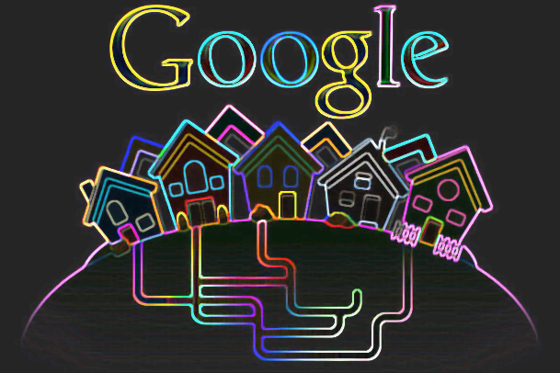
Streaming
At first, the company had to use Microsoft Silverlight, then It transition over to amazon cloud services in 2010.
Netflix uses OPEN CONNECT
Clarity can be seen with partnered OPEN CONNECT IPS
Notes:
which is something they developed and use with ISP (internet service providers) which allows them to connect directly with Netflix servers. Essentially working as a peering interconnection.

Slide 5
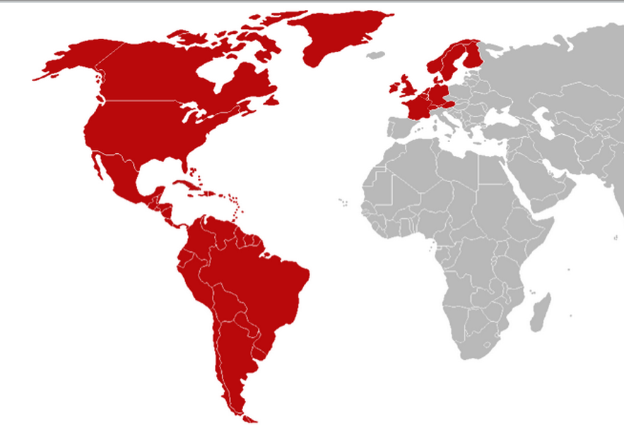
Streaming
Netflix currently streams in 80 different countries, too many to list
It will be expanded in the future.
The expansion over to 200 other countries is planed in the next 2 years.

Slide 6
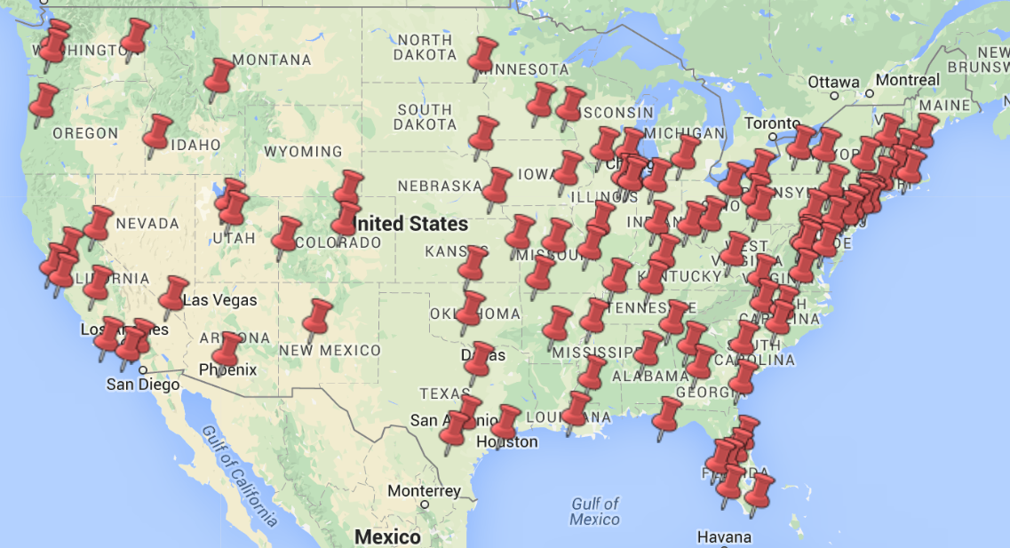
Streaming
about 10,00 and 20,000 movies at any given time. There are roughly 1,000 storage systems total.
Determines location based on
User per area
All streaming traffic is redirected to the closest server to ensure top quality streaming/

Slide 7

Streaming
Netflix will typically redesign is hardware once a year to keep up with its latest drive and low power Intel processors. Before placed in its server house, it will be loaded up with movies and shows.
All of the servers are run by the open source operating system FreeBSD, nginx web server and BIRD routing software with a Netflix software on top.

Slide 8

Streaming
Netflix has such high detail with streaming efficiency
Netflix use amazon web servers
Notes:
web servers is for tasks like running the website and its recommendations engine, also the move studio upload their content to the amazon cloud. Where Netflix encodes it to its format before distributing it to its network.
that all of the hard drive disk spins are carefully laid out to minimize “heat spots” or areas of overheating.

Slide 9
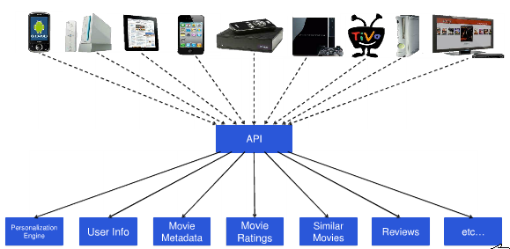
Netflix Api history
Launched on October 1st, 2008
Stopped issuing keys on March 8th, 2013
Retired its OData Catalog on April 8th, 2013
Why did the shift occur?
Netflix cancels it’s public API on November 14th, 2014
Notes:
Netflix will stop issuing API keys immediately and will not accept new API affiliates. The company will no longer offer a test environment for developer and its developer portal is already set to be read-only.
Odata: originally designed by Microsoft to standardise the way in which basic data access operations can be made available via REST. It’s built on top of Atom protocol and extends it by adding metadata to describe the data source and a standard means of querying the underlying data.
At this point, the apps already using netflix’s API were allowed access and were functioning.
Why did the shift occur? They are more about supporting netflix on all the devices it is available on.
To better focus our efforts and to align them with the needs of our global member base, we will be retiring the public API program. Effective on November 14, 2014, public API developers will no longer be able to access Netflix content. All requests to the public API will return 404 errors.

Slide 10
​Steps to build an app with NetFlix API
Sign up for mashery (which hosts Netflix’s API)
Register for an application key
Ex: Netflix API: k5mds6sfn594x4drvtw96n37 Shared Secret: srKNVRubKX
Get an OAuth request token.
http://term.ie/oauth/example/client.php
Endpoint: http://api.netflix.com/oauth/request_token
auth_token=bpn8ycnma7hzuwec5dmt8f2j&oauth_token_secret=DArhPYzsUCkz&application_name=JosephSmarrTestApp&logiuser.netflix.com%2Foauth%2Flogin%3Foauth_token%3Dbpn8ycnma7hzuwec
Ask the user to authorize the request token
https://api-user.netflix.com/oauth/login?oauth_token=bpn8ycnma7hzuwec5dmt8f2j&oauth_callback=YOUR_CALLBACK_URL&oauth_consumer_key=k5mds6sfn594x4drvtw96n37&application_name=JosephSmarrTestApp
Notes:
have to fill out some basic profile info and respond to an email round-trip
you say a bit about what your app does and it gives you a key and secret. When you submit the registration, it will give you a result like this. The first string is your OAuth Consumer Key and the second one is your OAuth Consumer Secret.
If you’re not ready to start writing code, you can use an OAuth test client
If your login URL is successfully constructed, it will take the user to an authorization page. If the user approves, they’ll be redirected back to your oauth_callback URL (if supplied), and your request token has now been authorized.
fill out both your consumer token and secret as well as your request token and secret. given the user_id for the authorized user, which you need to use when constructing the full URL for REST API calls.

Slide 11
​Steps to build an app with NetFlix API
Exchange the authorized request token for an access token
http://term.ie/oauth/example/client.php
Endpoint: http://api.netflix.com/oauth/access_token
oauth_token=T1lVQLSlIW38NDgeumjnyypbxc6yHD0xkaD21d8DpLVaIs3d2T1Aq_yeOor9PCIW2Bz5ksIPr7aXBKvTTg599m9Q–&user_id=T1G.NK54IqxGkXi3RbkKgudF3ZFkmopPt3lR.dlOLC898-&oauth_token_secret=AKeGYam8NJ4X
Make an API call using the access
Use OAuth test client again
Endpoint = http://api.netflix.com/users/userID/feeds
Fill out the consumer key and secret as normal
Fill out OAuth token and secret under the “request token / secret” fields

Slide 12
​Steps to build an app with NetFlix API
Fetch the feed of recently returned data.
[resource] [link href=”http://api.netflix.com/users/T1G.NK54IqxGkXi3RbkKgudF3ZFkmopPt3lR.dlOLC898-/queues/instant?feed_token=T1v23xnWpcYnhhkIsQ_iyASermOnPjgFKP77FdaXGkWEqUvwrPAjTeVHlgLpMlx2FF&oauth_consumer_key=k5mds6sfn594x4drvtw96n37&output=atom” rel=”http://schemas.netflix.com/feed.queues.instant” title=”Instant Queue”][/link]
[link href=”http://api.netflix.com/users/T1G.NK54IqxGkXi3RbkKgudF3ZFkmopPt3lR.dlOLC898-/rental_history/returned?feed_token=T1ksEAR97Ki14sIyQX2pfnGH0Llom4eaIDMwNWlUOmRZ0duD2YDbp_5PPUKBcedH51XSxPTnUOI5rCLz9feBXx9A–&oauth_consumer_key=k5mds6sfn594x4drvtw96n37&output=atom” rel=”http://schemas.netflix.com/feed.rental_history.returned” title=”Titles Returned Recently”][/link] [/resource]

Slide 13
Netflix api examples
Uses the HTTP GET request for the URL for a specifc resource.
Example:
This will bring you back the entire catalog that Netflix has to offer.
Next if you want to bring information about a specific title, you can use the HTTP link return as a resource itself.

Slide 14
Cont..
Exctract the URL resource for the movie and you could use it with the GET method.
If client does not support http verbs, this will not function correctly.
All responses are in XML
Extensible Markup Language
Notes:
If your client does not support all four HTTP verbs, or if your GET request exceeds the URL size limits, you can use the HTTP POST verb instead. When you use POST in this way, either set the X-HTTP-Method-Override header to GET, PUT, or DELETE, or pass a method parameter whose value you set to the HTTP method you want to use (GET, PUT, or DELETE).

Slide 15
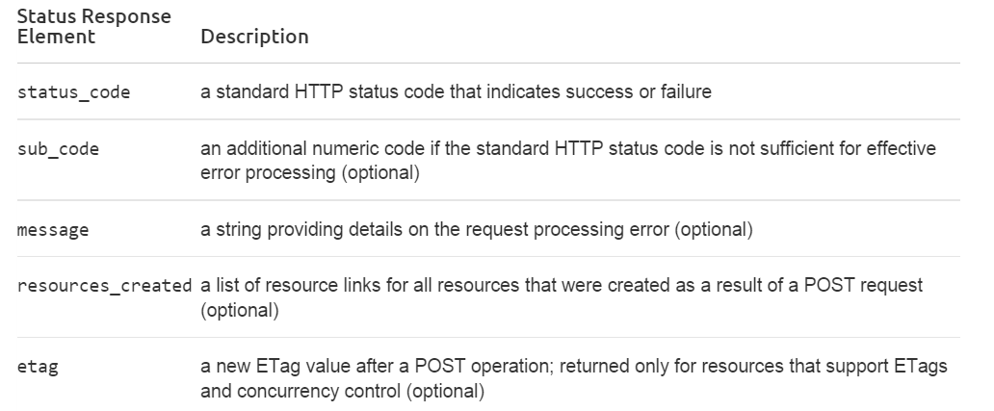
Built in error handler
Notes:
On every request the api will return a serious of data in which could result in different amount of information whether It was successful or the possible cause of failure.

Slide 16
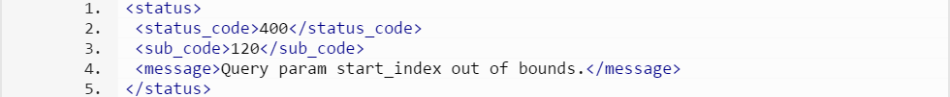
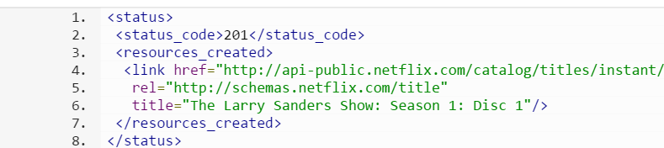
Example of return
Failure return
Successful return

Slide 17
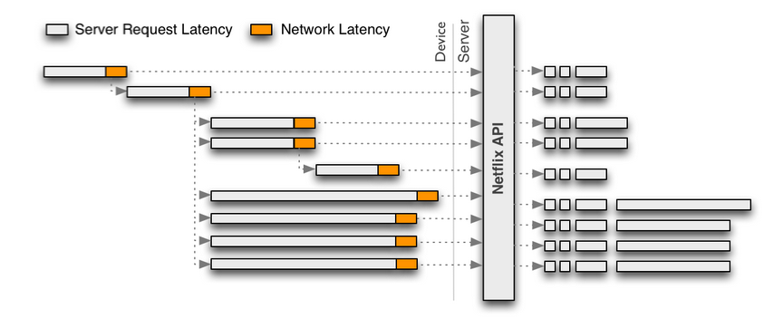
Before
Notes:
Due to the generic and granular nature of the original REST-based Netflix API, each call returns only a portion of functionality for a given user experience, requiring client applications to make multiple calls that need to be assembled in order to render a single user experience. This interaction model is illustrated in the following diagram:

Slide 18
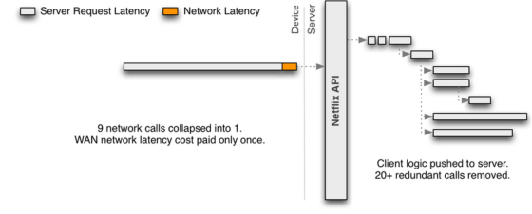
After
Notes:
A single optimized request such as this must embrace server-side parallelism to at least the same level as previously achieved through multiple network requests from the client. Because the server-side parallelized requests are running in the same network, each one should be more performant than if it was executed from the device. This must be achieved without each engineer implementing an endpoint needing to become an expert in low-level threading, synchronization, thread-safety, concurrent data structures, non-blocking IO and other such concerns.

Slide 19
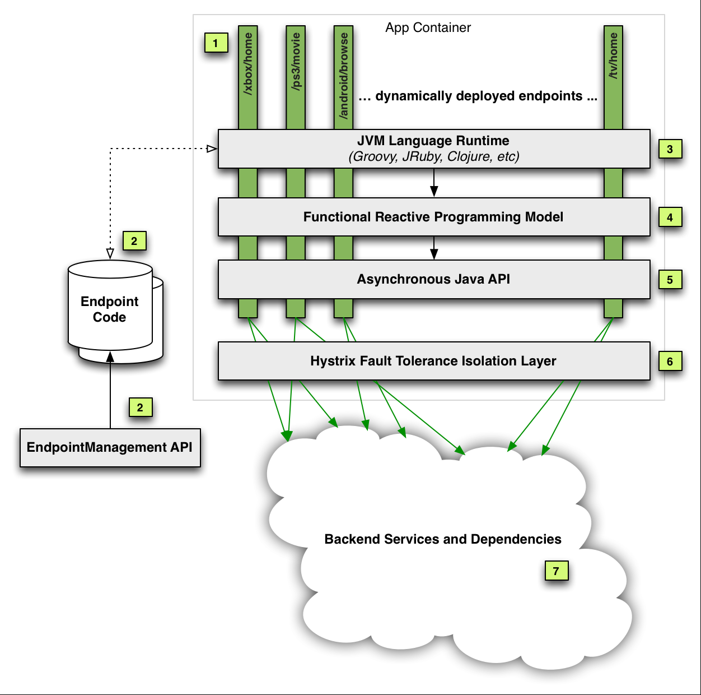
Use of polyglot
Dynamic
Real-time execution
Use of java API
General architecture of the API
Notes:
Current architecture that uses polyglo of JVM languages developed by Netflix
Engineers implementing endpoints come from a wide variety of backgrounds with expertise including Javascript, Objective-C, Java, C, C#, Ruby, Python and others. The system should be able to support multiple languages at the same time.

Slide 20
Implications of netflix shutting down its Public api
Two main behaviors that Netflix wants to prevent by doing this
Independent Developers felt cheated
Consumers used third-party apps to add titles to their DVD queue and could not do that anymore
Notes:
The biggest change to the API is that Netflix will no longer share its rental history with third-party developers. That includes movies that Netflix users have streamed or received through its DVD-by-mail service. With the new Terms of Use, there are two main behaviors that Netflix is trying to prevent: First of all, it’s hoping to stop developers from reselling technology and information from the Netflix API to third parties. And secondly, it’s trying to stop developers from scraping its metadata and using it to advertise competing services.
A lot of independent developers were not happy with this decision as they felt cheated by Netflix. They felt that it was not right of Netflix to offer up these APIs and these developers to have created apps and websites using the APIs to help Netflix users. Then Netflix shutting the APIs down.
On January 11th, 2011 Netflix stopped allowing users to add titles to their DVD queue from the netflix apps on all their devices. Users could only do that through the website now. Users started using third-party apps to add titles to DVD queue and they were all affected when these APIs were taken down and all those apps started erroring out with 404 errors.

Slide 21



Implications on Innovation from Public api being shut down
Notes:
We are moving away from branding and innovation exercise/experimentation mode to profit, monetization, revenue and better control mode. I am sure that all these companies had a great strategy in place when they built these programs originally. But the need has changed over the years.

Slide 22
Netflix did let the following websites transition to a non-public api
Instant Watcher
FanTV
Yidio
NextGuide
Flixster
Can I Stream It?
FeedFliks
Instant Watch Browser for Netflix

Slide 23
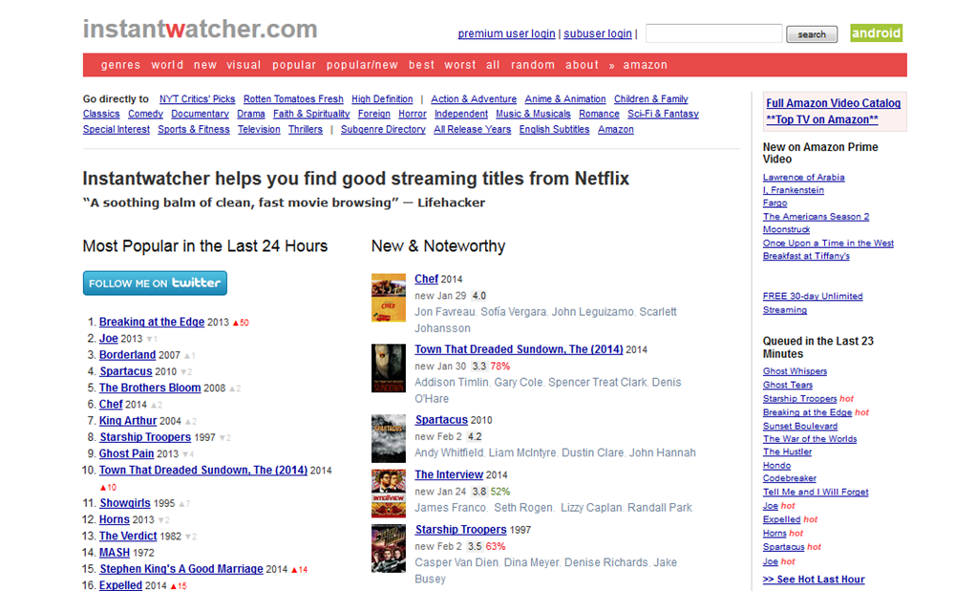
Brings you instant
Knowledge of whats
Trending
Ability to play
Directly from the
website
Uses the Netflix
API to build its own
Database
Notes:
It's for Netflix users who want to traverse and explore Netflix's catalog of streaming titles more efficiently and painlessly. All the information and cross-links on this website are limited to Watch Instantly titles so you don't have to waste time sifting through a bunch of DVD-only titles to find the ones that you can start watching right away.
You can also play or queue these titles directly from this website. This website uses the Netflix API to build its own, separate database of Netflix's streaming titles. This website is not owned or controlled by Netflix, but is the sort of useful innovation Netflix wants to encourage by making its API available.

Slide 24

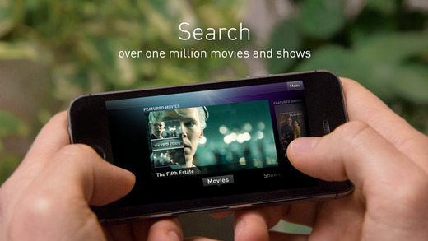
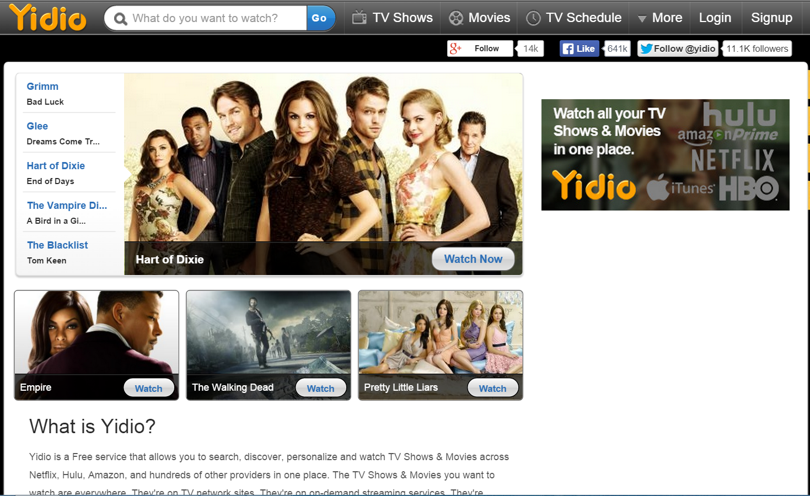
Notes:
FanTv ties together the searchable content libraries of the ABC iPad app, Hulu Plus, Netflix, Crackle, iTunes, and Vudu, and searches all of them via its relatively clean interface. FanTvis an app that intends to help users tackle this problem by tying together a media-browsing interface and search that doubles as a launcher for those TV shows and movies. The app launched earlier this year, but a recent app update has added more features, including a Facebook connection.

Slide 25
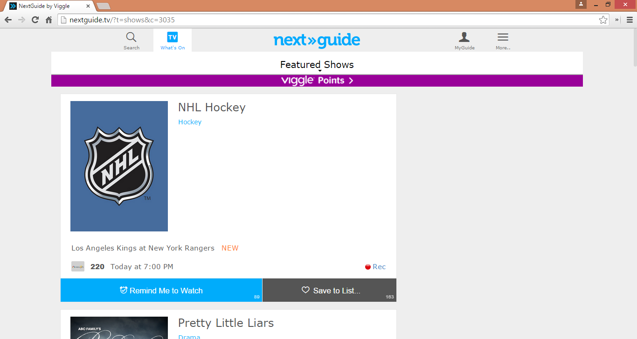

Notes:
NextGuide is the “hyper-personalized” guide for streaming and live TV that helps answer the question “what should I watch next?” and transforms the way people discover TV shows and movies for viewing either on the TV or on their iPad™. NextGuide combines listings from any live TV service with movies and TV shows that can be found and played on services including Netflix and iTunes, with rich searching capability, alerts, and one-click watching. The app also has powerful social features, and uses a person’s Facebook friends’ interests and their own profile to make recommendations.
Flixster, which allows you to add movies to your Netflix queue and use your rental history to post reviews and opinions.

Slide 26
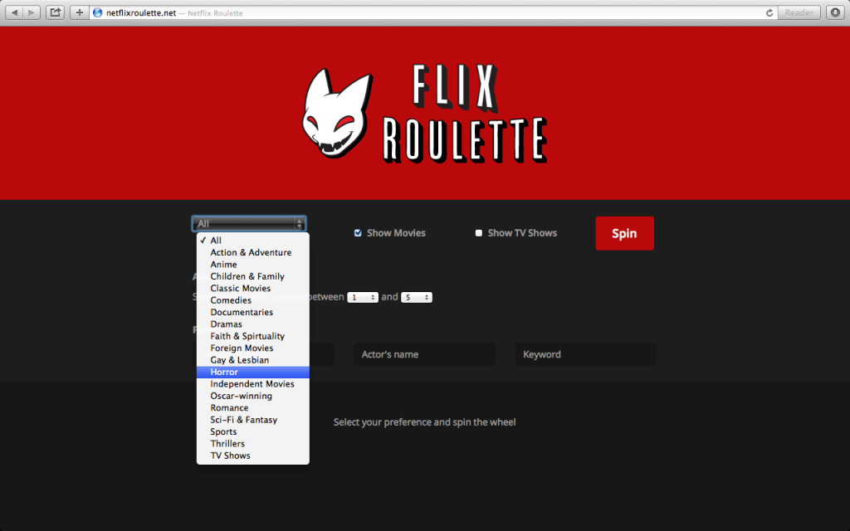
Netflix roulette
URL: http://netflixroulette.net/
Notes:
developers access to the Netflix Roulette Database, simply because its so much useful information being used on such a simple web application.
With Netflixs official API no longer giving out new keys; I've decided to do away with all of that and make this an Open API. You're free to query as much information as you'd like. Just be sure to mind our bandwith.

Slide 27
Web API
http://netflixroulette.net/api/api.php?title=Attack%20on%20titan
http://netflixroulette.net/api/api.php?title=Friends&year=1994
Notes:
The Web API is the centre of everything, from here you can get all the neat information about titles within the Netflix catalogue
Here: two examples in the api will return all given information

Slide 28
XML Examples
http://netflixroulette.net/api/api.php?title=House%20of%20cards&type=xml
Without JSON: http://netflixroulette.net/api/api.php?title=House%20of%20cards&type=plain
Notes:
JavaScript Object Notation, is an open standard format that uses human-readable text to transmit data objects consisting of attribute–value pairs. It is used primarily to transmit data between a server and web application, as an alternative to XML

Slide 29
XML
http://netflixroulette.net/api/api.php?director=Quentin%20Tarantino&type=xml
http://netflixroulette.net/api/api.php?actor=Nicolas%20Cage&type=xml

Slide 30
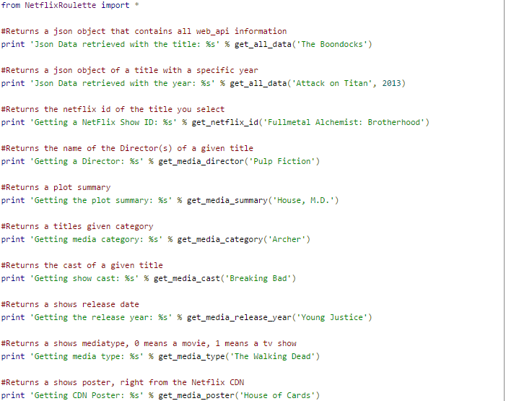
Python wrapper

Slide 31
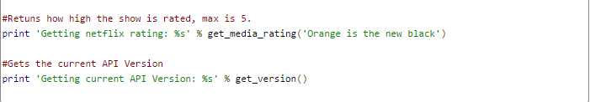
Python wrapper

Slide 32
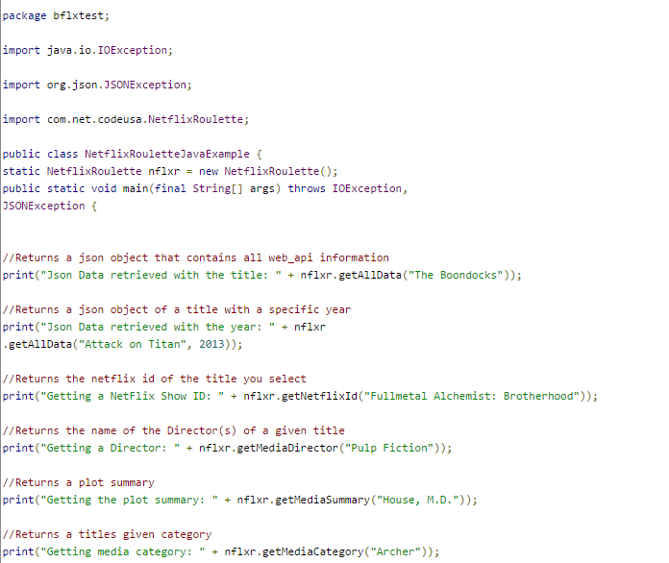
Java wrapper

Slide 33
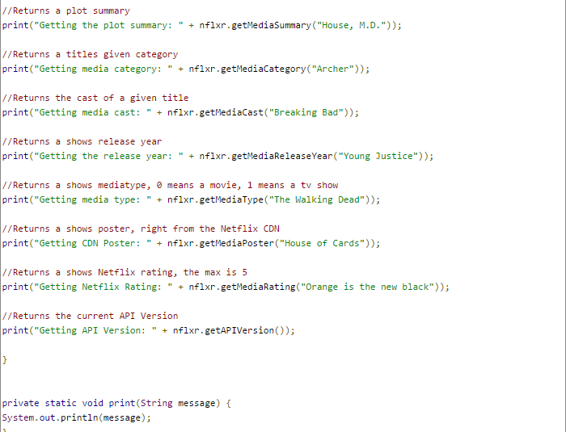
Java wrapper

Slide 34
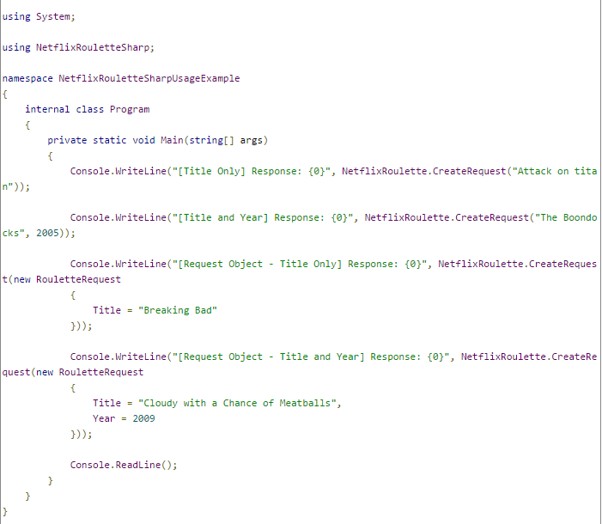
C# wrapper

Slide 35
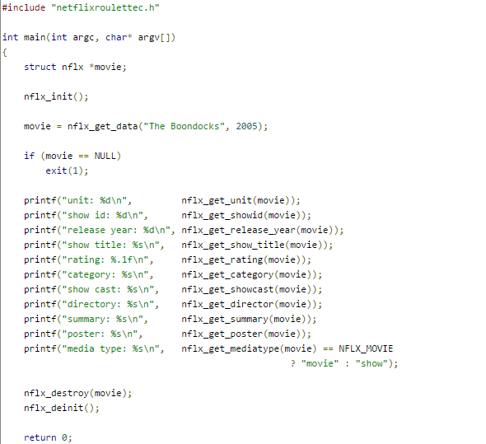
CMake
Notes:
You need CMake in order to build NetflixRouletteC. CMake is a cross-platform build file generator. On Windows, use CMake to generate Visual Studio build files, or build files for your preferred IDE(Integrated Development Environment). You can also do this on Linux. If you prefer Linux terminal commands and don't want to use an IDE, then run these commands to download and build NetflixRouletteC

Slide 36
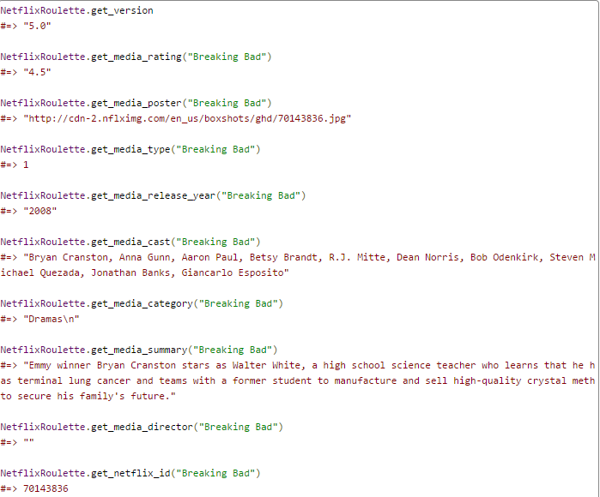
Ruby wrapper

Slide 37
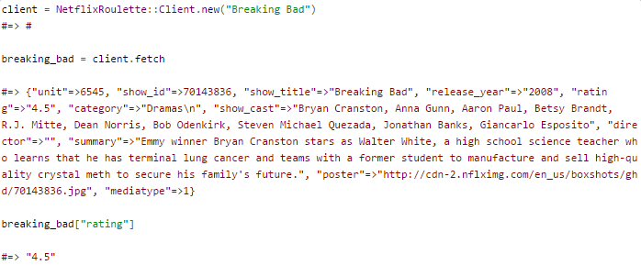
Ruby wrapper
Notes:
Access the client directly

Slide 38

Netflix bot commands
/u/netflixbot movie1
/u/netflixbot Director: Quentin Tarantino
/u/netflixbot Actor: Bruce Willis
Notes:
Explain the calls and what /u/ means

Slide 39
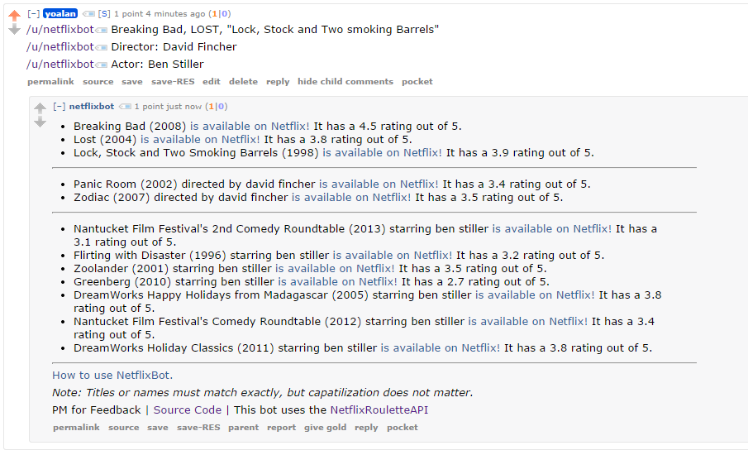
Example in action:
First result for titles
Director
List of movies from actor.

Slide 40
Searching for genres
This is one of Netflix's biggest drawback. This can be accomplished through other means:
http://www.netflix.com/WiAltGenre?agid=
http://www.docdroid.net/h6sb/netflix-id-liste-.pdf.html

Slide 41


